Slide 1


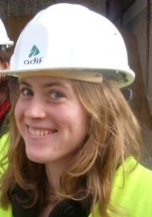

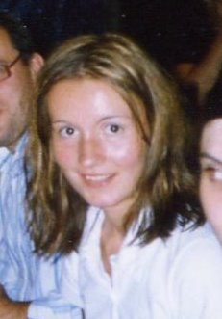
Design Team – Spring 2009
Sara
Reiko
Heather H
Heather H
Adela

Slide 2
What We Do
- Update the MathCAD algorithms as new research dictates better understanding of processes
- Edit the AutoCAD files to draw plants as we change designs
- Work on specific plant designs in Honduras as the need arises during the semester
- Assist with developing the design tool

Slide 3
Outline
Major Plant Changes
Coding
Design Tool
Challenges

Slide 5
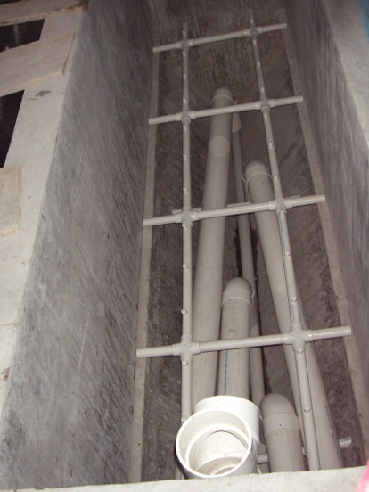
Inlet Manifold Old Design

Slide 6
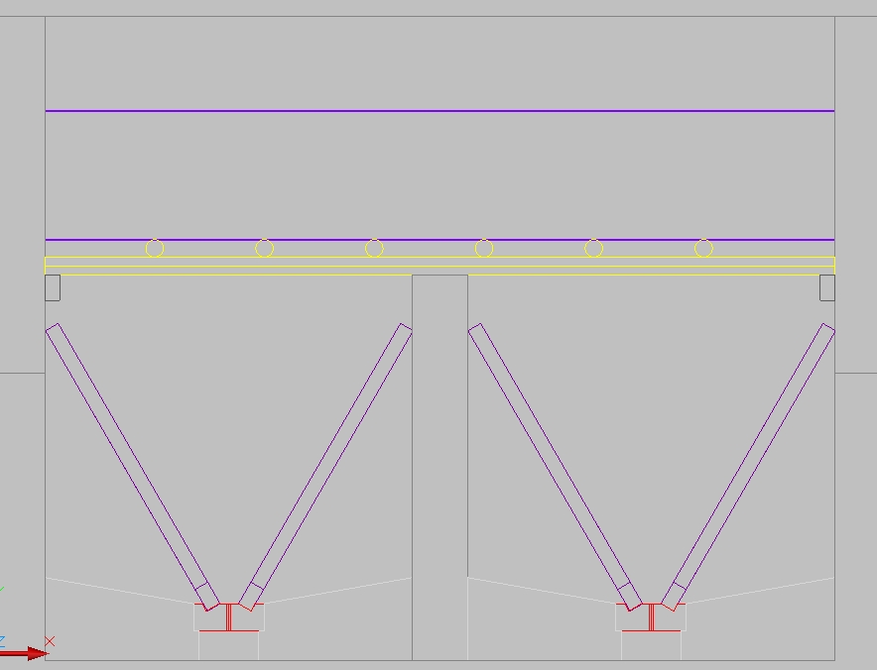
Inlet Manifold New Design

Slide 7
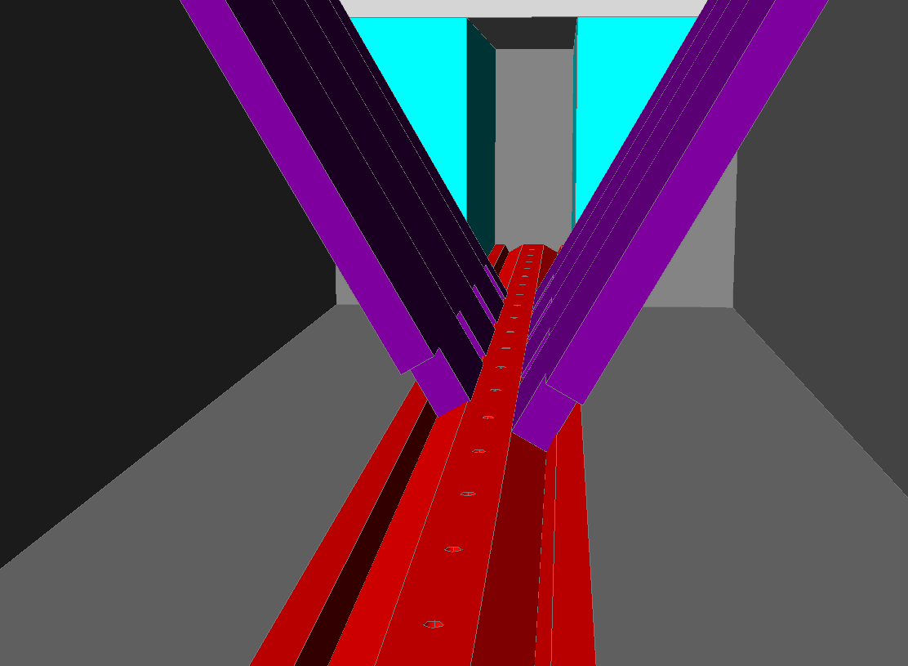
Inlet Manifold New Design

Slide 8
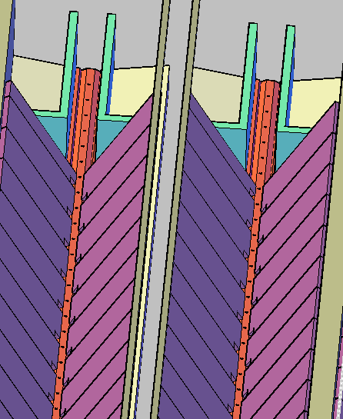
Inlet Manifold New Design

Slide 9
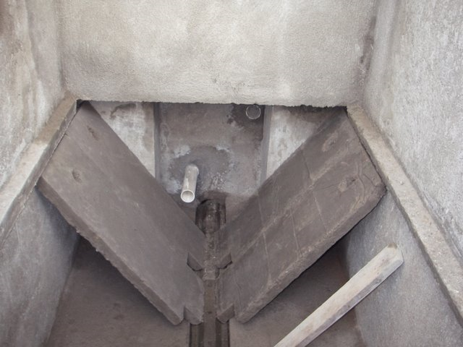
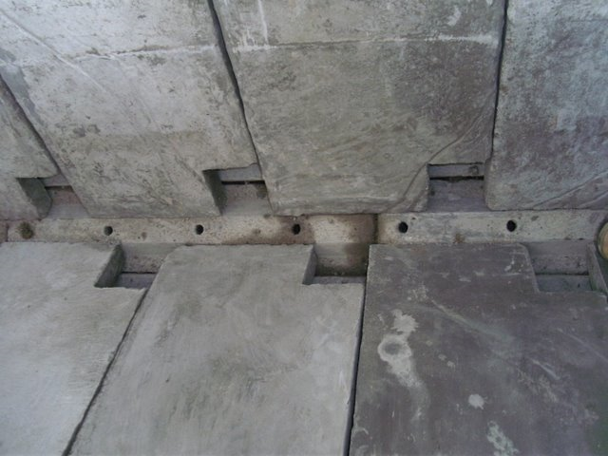
Cuatro Communidades Sed Tank

Slide 10
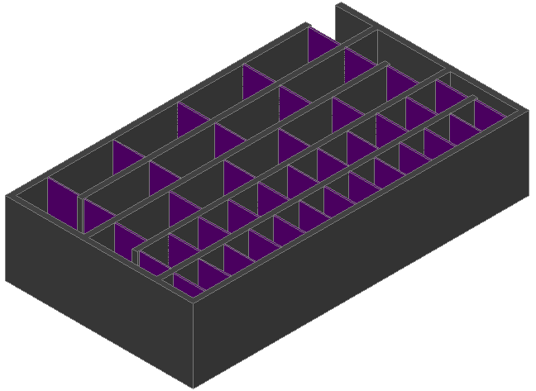
Flocculator Changes
Use energy dissipation rate, ε, instead of GΘ
Break-up of flocs based on varying energy dissipation rates

Slide 11
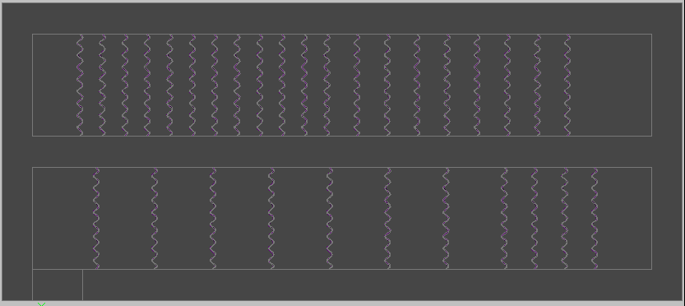
Flocculator Changes
Changed design of baffles spacing to a single spacing for a single channel
Old design

Slide 12
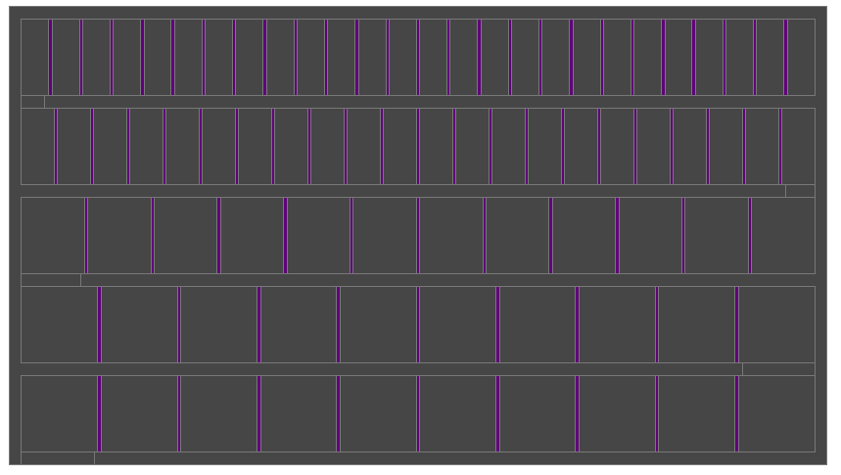
Flocculator Changes
Changed design of baffles spacing to a single spacing for a single channel
New design

Slide 13
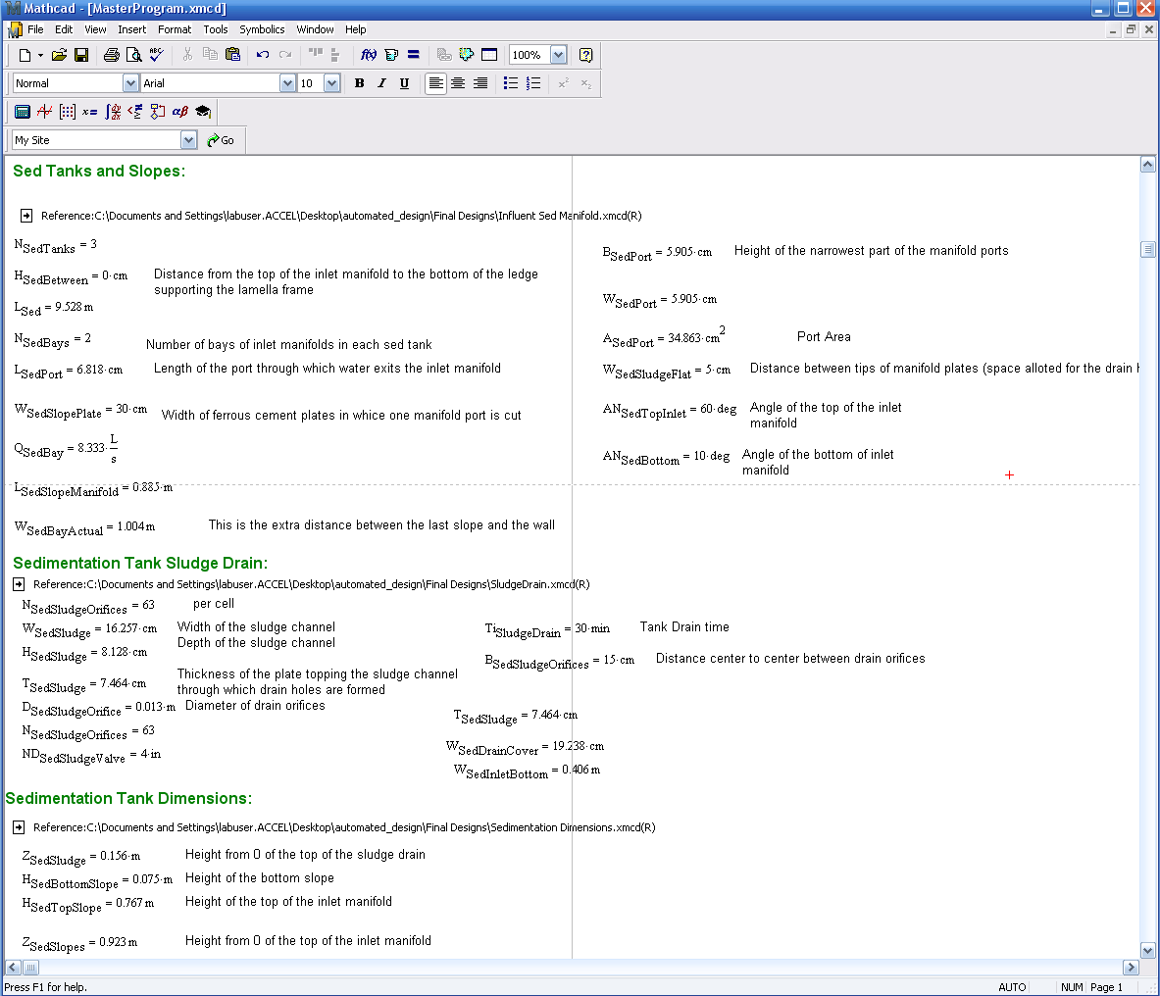

Slide 14
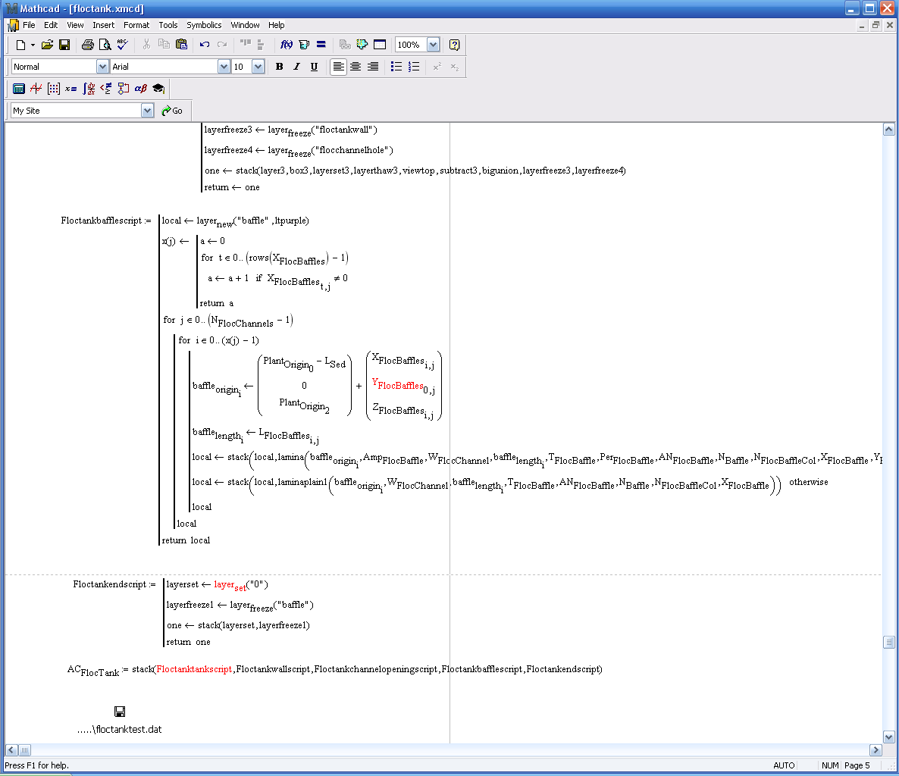

Slide 15
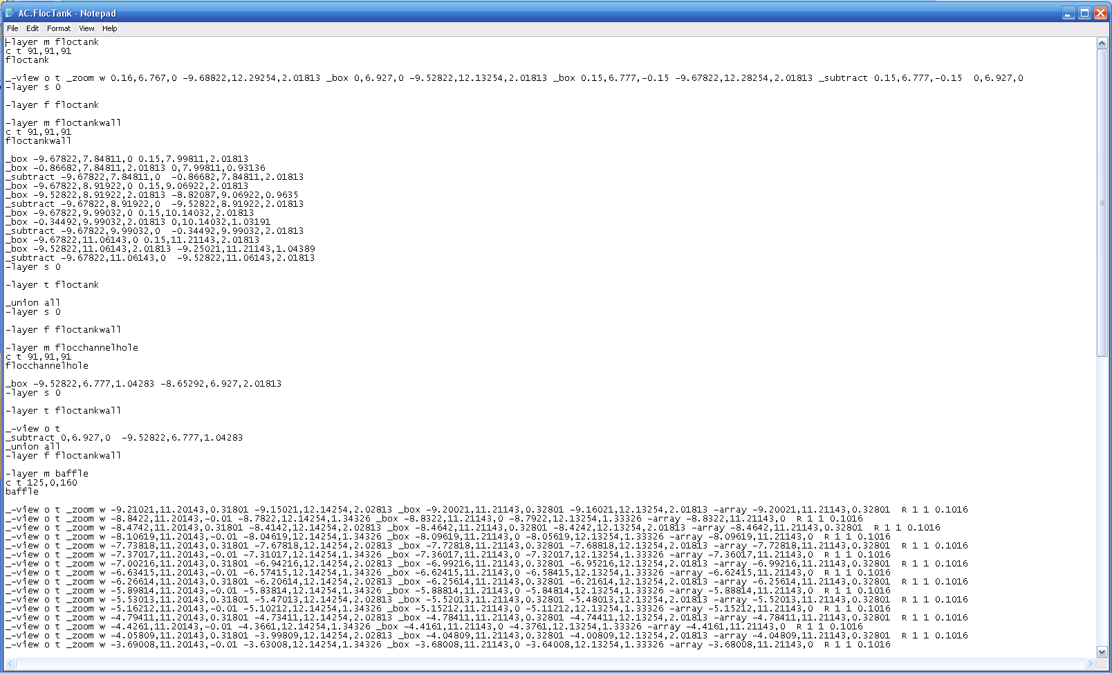

Slide 16
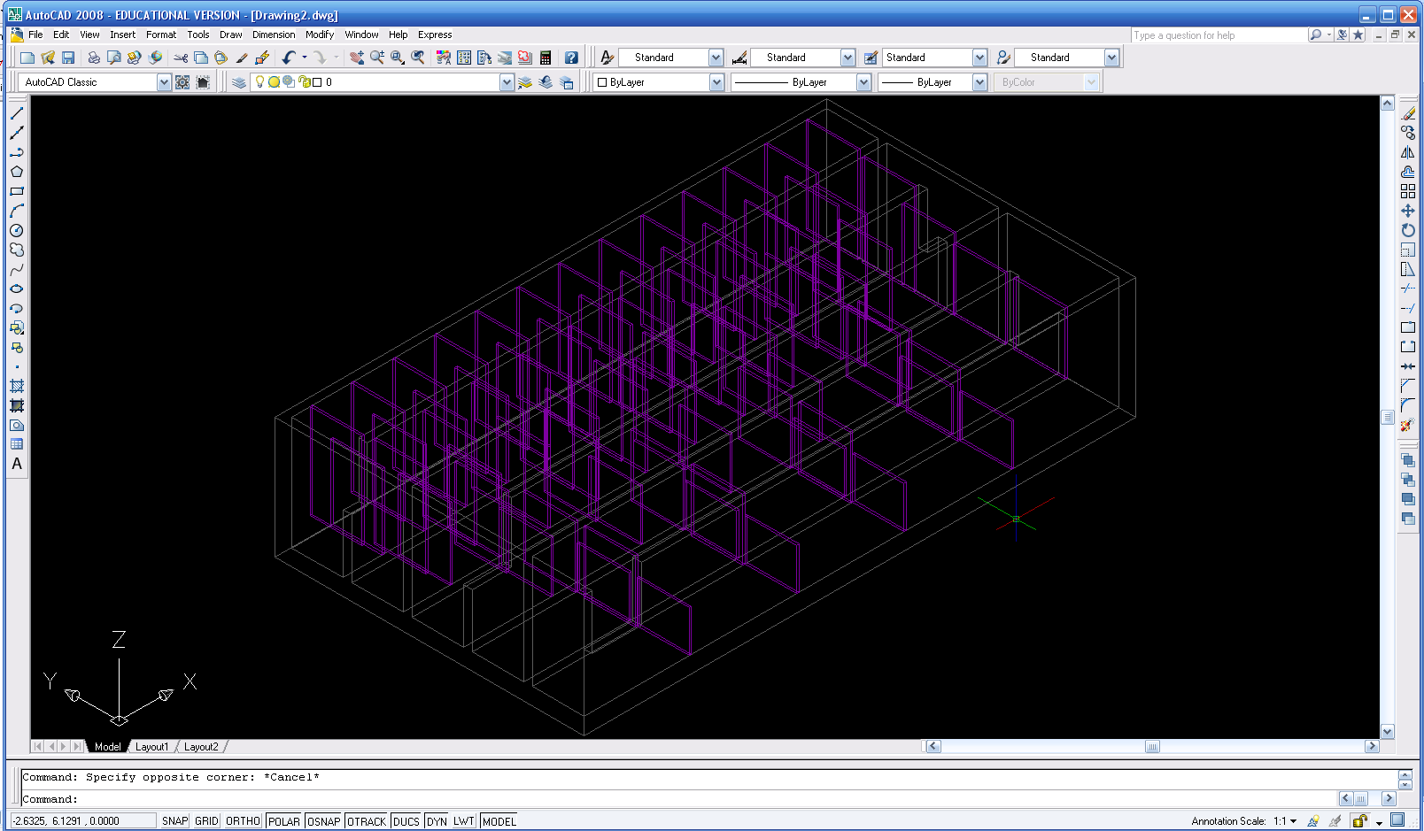

Slide 17
AguaClara Design Tool
In Class Demonstration

Slide 18
Future Challenges
Determine efficient ways to debug, design tool issues
Experiment with best way to return autoCAD scripts to labview
Keeping code up to date with technological changes
Testing all aspects of code for scalability issues
Develop stand alone design explanation packet
Document all AutoCAD improvements

Slide 19
Questions?

